Slide 1

Hydra – classifiers comparison using plants dataset

Slide 2

Agenda
Project goals
Problem definition
Scope of the project
Literature review
Dataset introduction
Artificial Neural Network classifier
Decision Tree classifier
SVM classifier
Classifier comparison experiments
Conclusions
Future recomendations

Slide 3

Scientific Goals
Review the litrature on the image recognition task
Implement 3 different classifiers (Artficial Neural Network, Decision Tree, SVM – Support Vector Machine)
Prepare and conduct experiments with these classifiers
Compare their performance with each other
Present results and formulate conclusions

Slide 4
Project Motivation
Initial idea was to build one classifier
With the research and classes this idea evolved into 3 classifiers comparison
Somewhat familiar task of image recognition
Curiosity

Slide 5
Problem definition
What is the difference in accuracy between Artificial Neural Network, Decision Tree and SVM classifiers in the image recognition task?

Slide 6
Scope of the project
Wide-scoped literature review
Selected dataset introduction
Artificial Neural Network classifier implementation and experiments
Decision Tree classifier implementation and experiments
SVM classifier implementation and experiments
3 classifiers comparison experiments
Presentation of results
Formulated conclusions

Slide 7

Literature review

Slide 8
Machine Learning Applications based on SVM Classification: A Review [SVM, 2021]

Slide 9
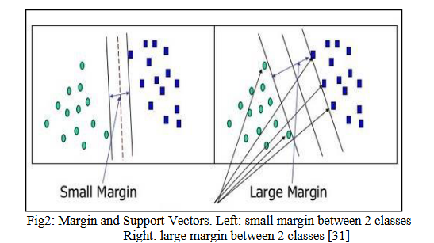
Paper overview
,,This paper explored active approaches that are implemented using SVM classifier in different research fields.”
Face detection and recognition
Text Recognition
Disease diagnosing
Sentiment Analysis
Plant disease Identification
Intrusion Detection
and many more.
Figure 2 from the cited paper

Slide 10
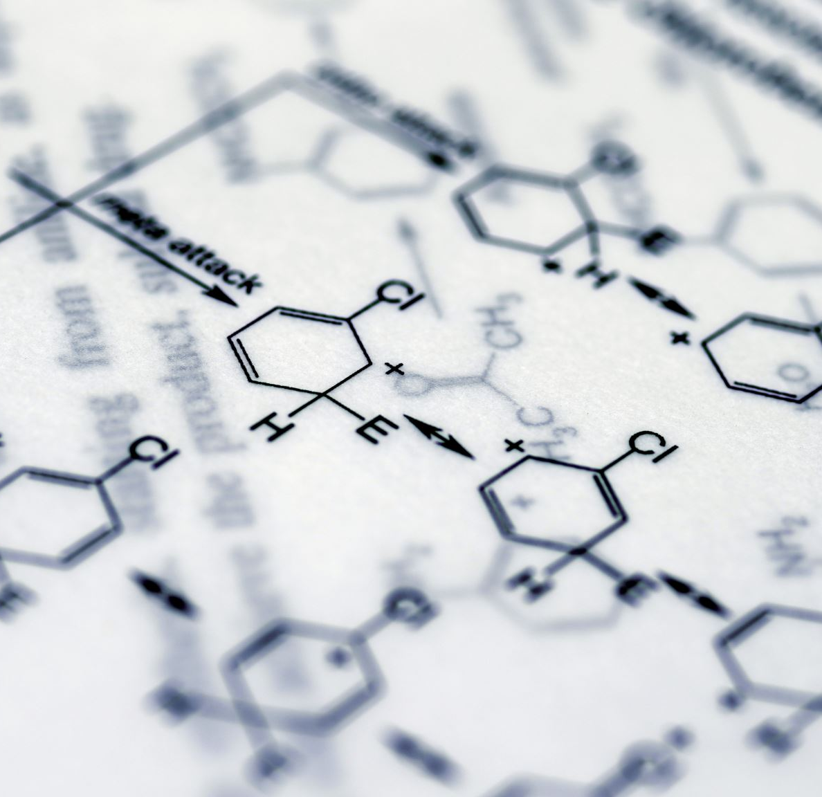
Success of this research
Based on their research they have concluded that SVM can be efficiently used in tasks like
Facial recognition (97.47% accuracy)
Diseases diagnostics (97% accuracy in cancer identification)
Sentiment analysis (77% accuracy)

Slide 11

Water Quality Management Assessment and Interpretation [ANN, 2014]

Slide 12
Paper overview
This book focuses on water quality management
Not all of it is useful for our research
Only the theorietical part which explain Artificial Neural Network

Slide 13
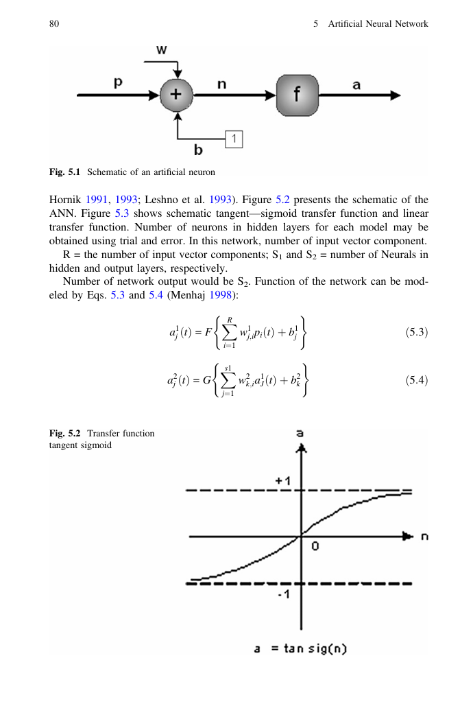
Example: Page 80 of the cited book

Slide 14
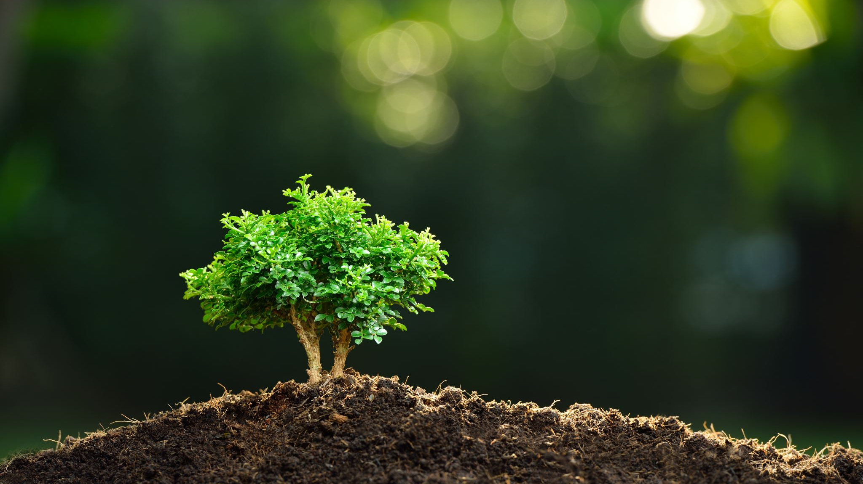
Predictive Analytics in Business Analytics: Decision Tree

Slide 15
Paper overview
This paper focuses on predictive analytics, which is a branch of business analytics
It is not necessary that useful for our research
However is presents the theory for Decision Tree

Slide 16
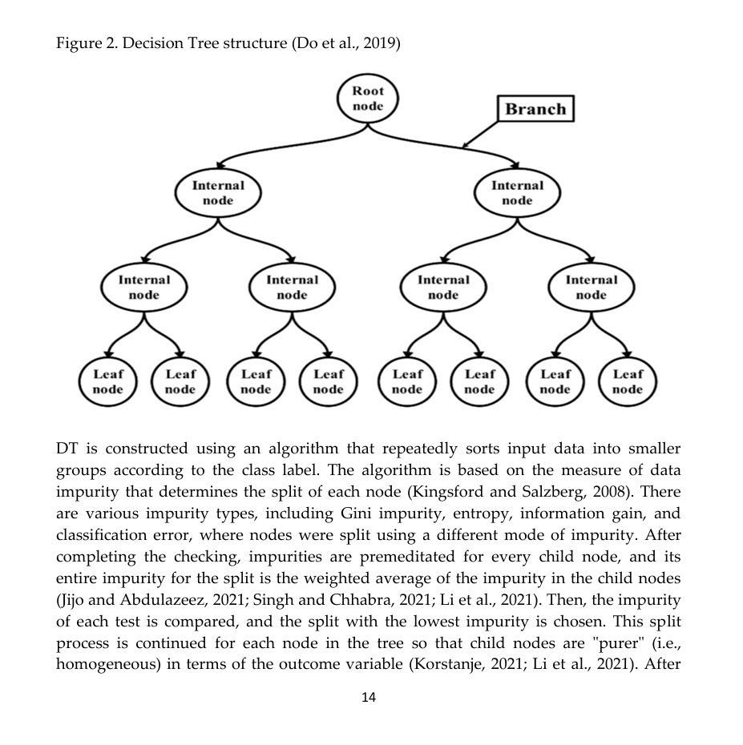
Part of the page 14 of the cited paper

Slide 17

Machine learning-based image recognition for rural architectural planning and design [RA, 2025]

Slide 18
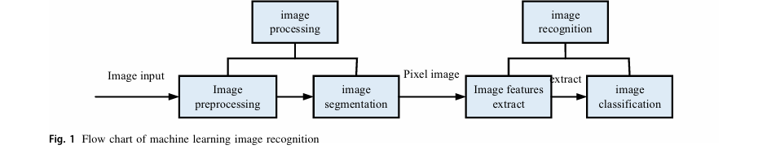
Paper overview
This paper focuses on image recognition of buildings and application and development strategy of rural architecture design. They utilize image processing and recognition. The method they have utilized is extremely similar to our plan since not only will we pre-process images to fit them into the ResNet50 model, but also our flow chart of image recognition would be almost identical to theirs. Above, we’ve presented fig. 1 from the cited paper which showcases their pipeline for image recognition.

Slide 19

Dataset

Slide 20
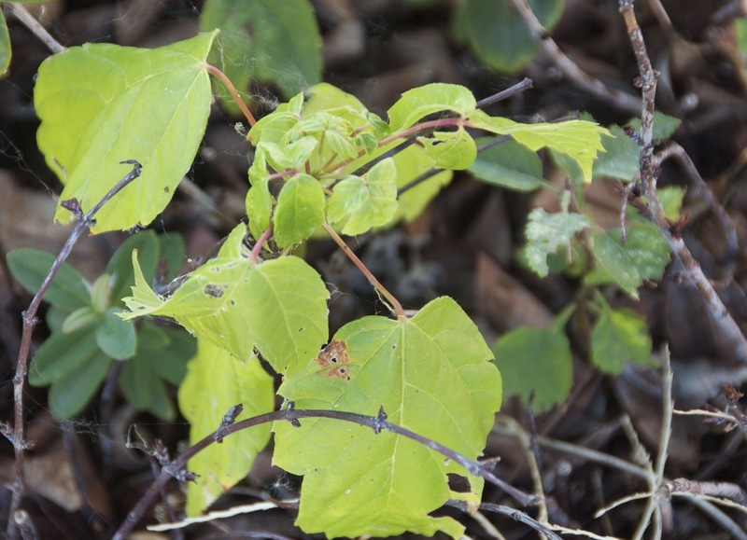
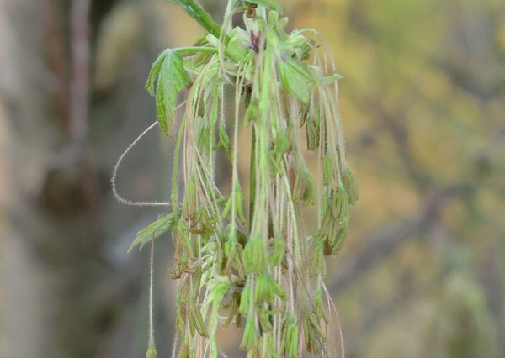
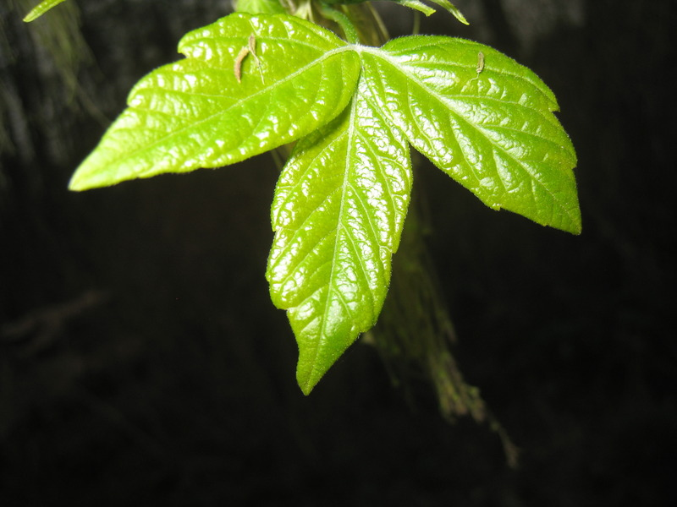
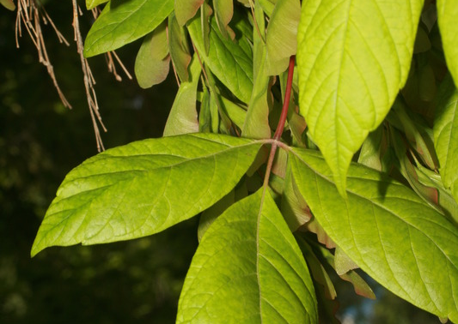
Dataset selection
Chosen dataset: Planclef Dataset ^{[1]}
Consists of 1000 classes
It is an imbalanced dataset of plants species labeled by their names
[1] https://www.kaggle.com/datasets/ datajameson/planclef

Slide 21
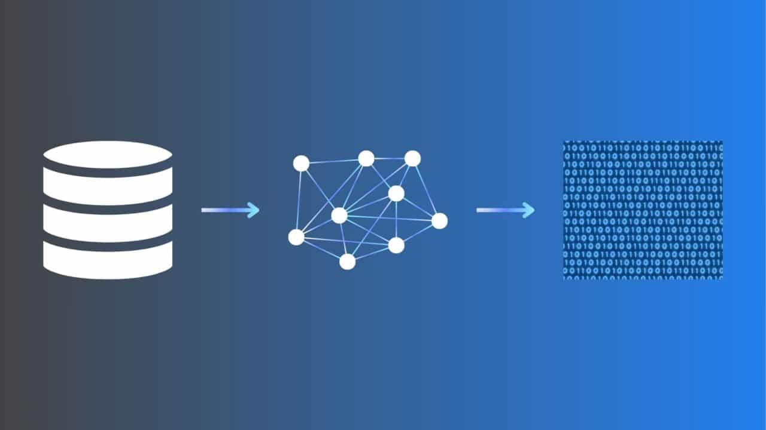
Feature Extractor:
ResNet-50

Slide 22
Data pre-processing: Balancing
Imbalanced datasets can lead to various problems, particularly the model prioritizing the majority class over minority classes.
The dataset was balanced by: - removing classes with < 100 samples (Filtering) - classes with > 100 samples were reduced (Undersampling)

Slide 23

Data pre-processing: Decreasing the number of classes
For some experiments only the subset of classes was used because of the model's limitations.

Slide 24


Research Enviroment

Slide 25
Measures
Accuracy
Time

Slide 26
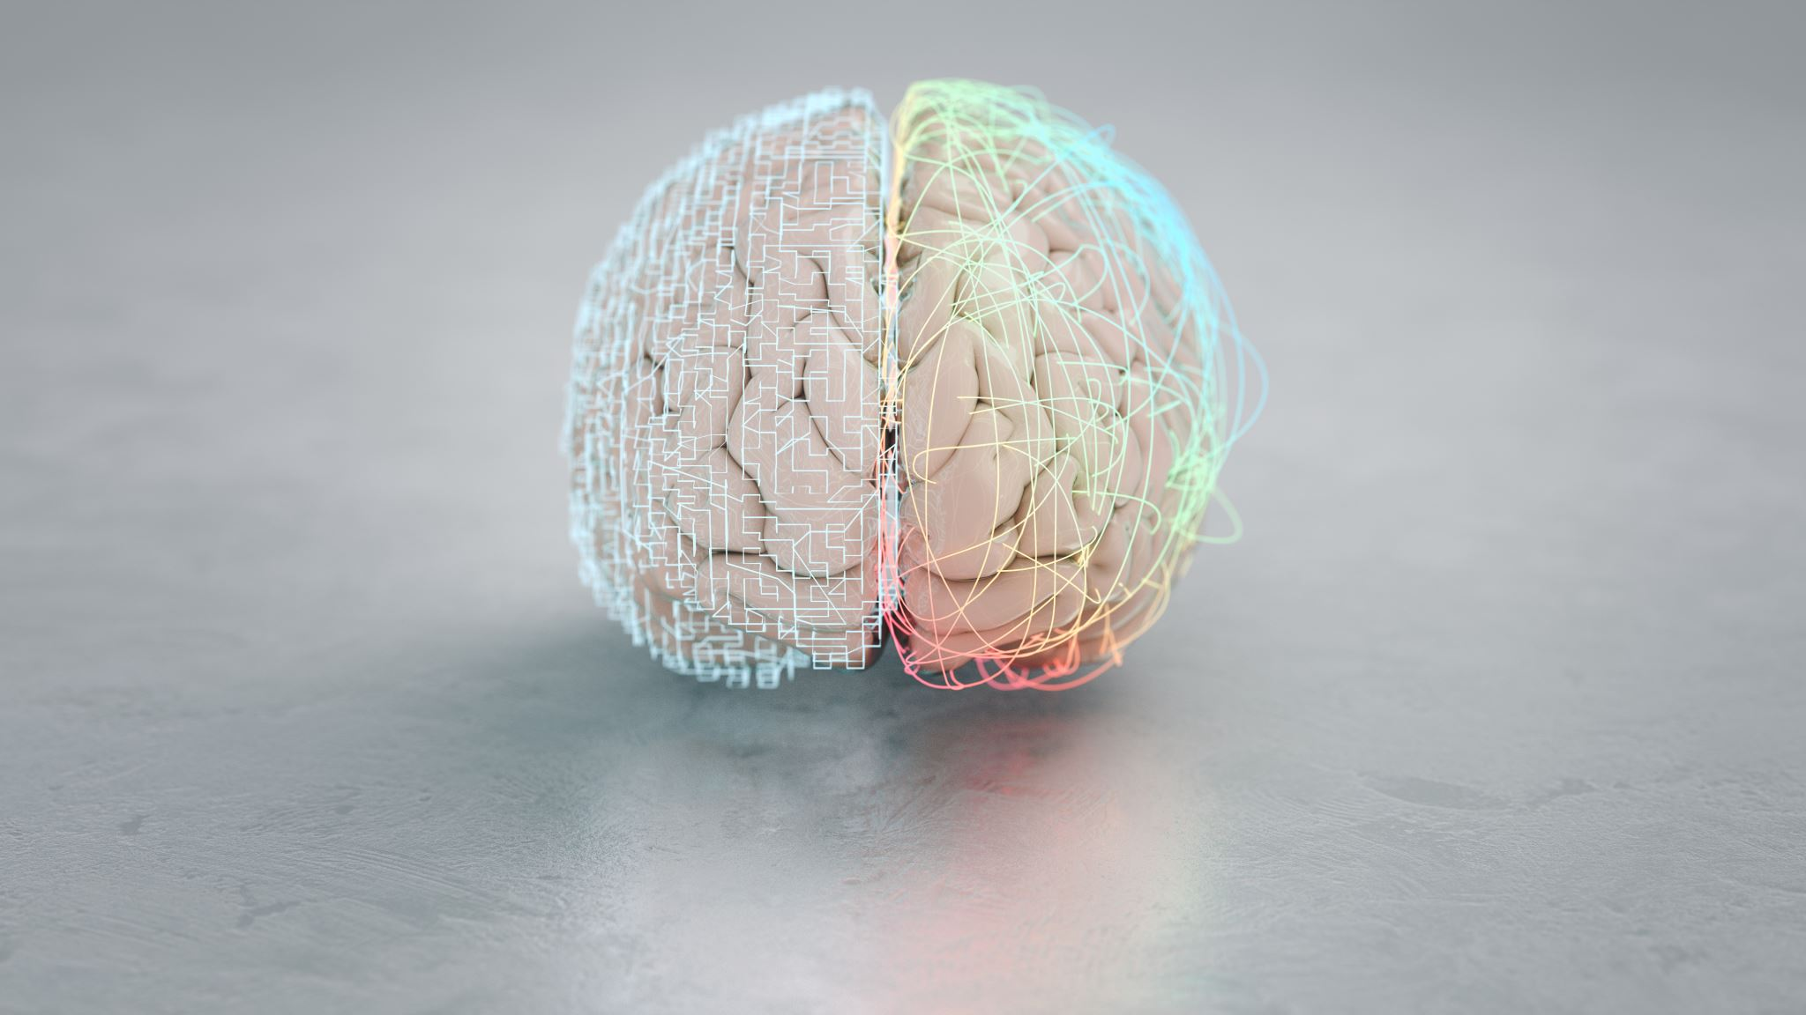
Artificial Neural Network

Slide 27
Inspiration
Building a neural network FROM SCRATCH (no Tensorflow/Pytorch, just numpy & math)
By Samson Zhang

Slide 28
Main algorithms / methods used
Backpropagation
Forward propagation
Parameters updates

Slide 29
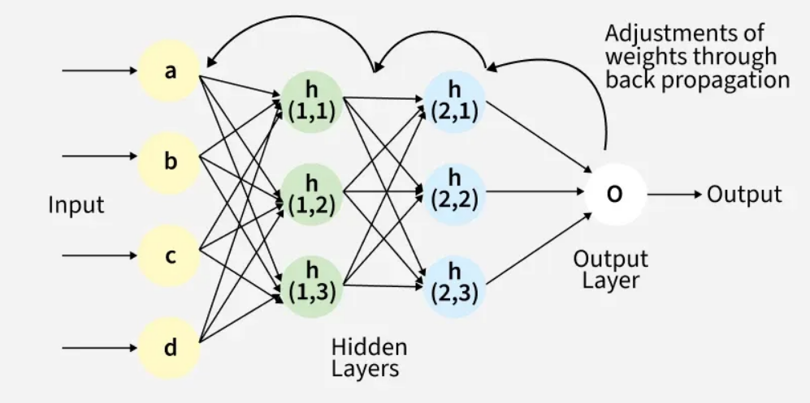
Artificial Neural Network

Slide 30
Main problem of this classifier
One class fixation of the network

Slide 31
Experiments
Main focus of experiments was balancing the learning rate hyperparameter to discover this operation’s efficacy and results
Other types of experiments:
30 Epochs experiment
Balanced dataset experiment
0.05 Extreme Learning Rate experiment

Slide 32
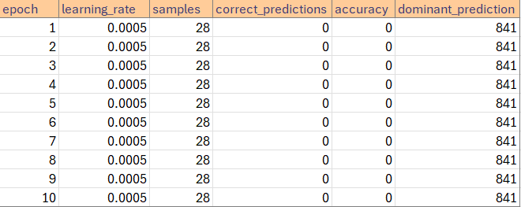
LR: 0.0005 – Imbalanced dataset

Slide 33
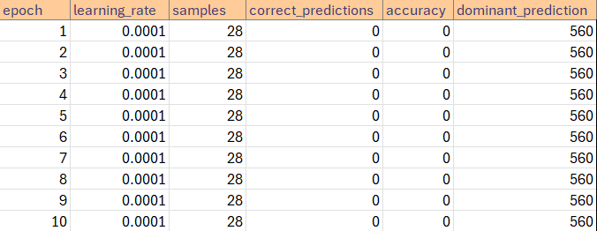
LR: 0.0001 – Imbalanced dataset

Slide 34
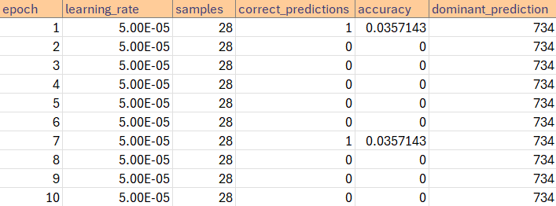
LR: 0.00005 – Imbalanced dataset

Slide 35
Balanced dataset shape
One of the experiments was intended to check if balancing the dataset would resolve one class fixation problem
Final shape achieved -> (21950, 2048) that is: 21950 samples, 2048 ResNet50 embeddings each

Slide 36
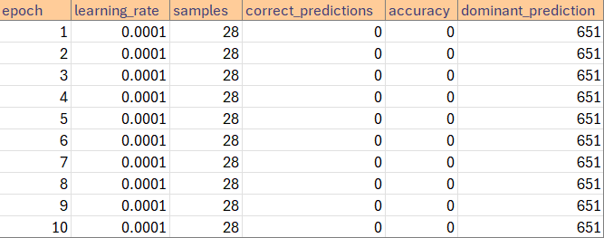
LR: 0.0001 – Balanced dataset

Slide 37
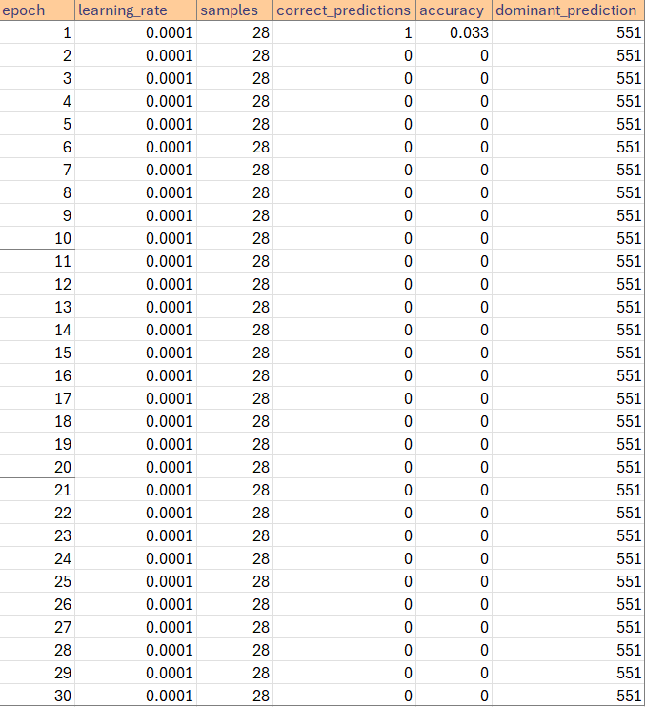
30 Epochs experiment – balanced dataset
Experimented with 30 epochs to discover if too small amount of epochs was the cause of one class fixation problem
Results did not mark too tiny amount of epochs as the root cause of the one class fixation problem

Slide 38
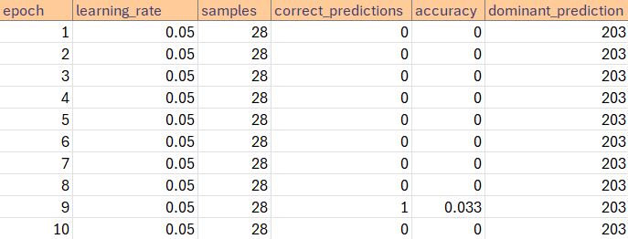
0.05 LR Experiment – Balanced Dataset

Slide 39
Experimentation conclusions
The correctness of the implementation of the artificial neural network was confirmed.
Problem of one class fixation upen Planclef dataset remaines unsolved.
Experiments did not yield a discovery to this problem’s solution on this dataset.
Further suggestions include continuation of experiments to discover the root of this problem.

Slide 40
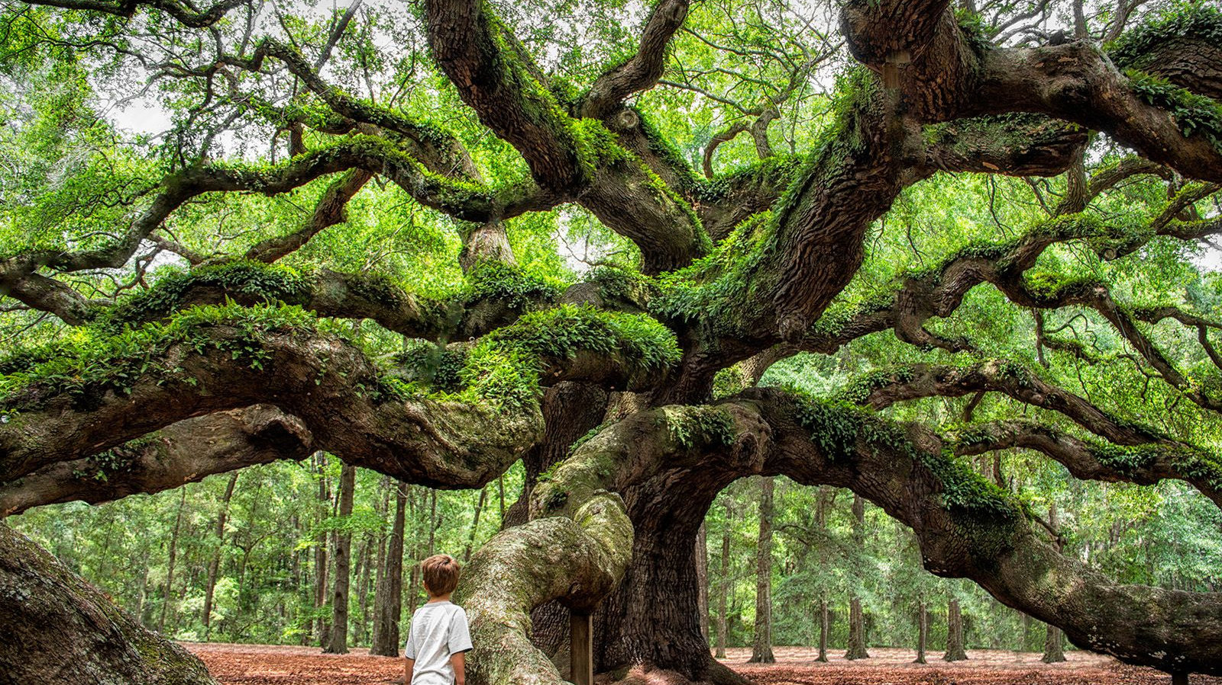
Decision Tree

Slide 41
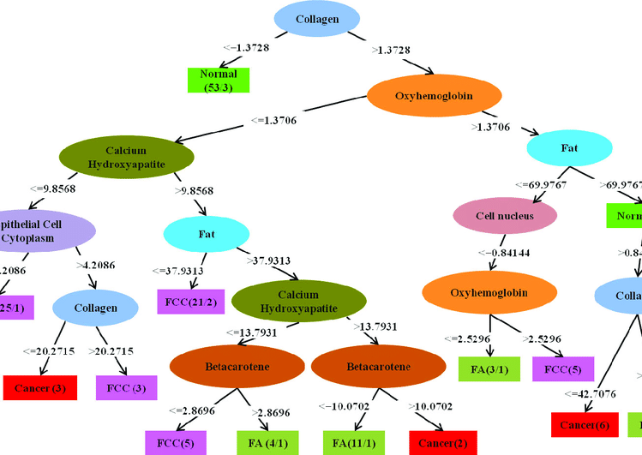
At each node C4.5 evaluates all features and selects the one that best separates the classes (highest gain ratio).
For the chosen feature, the split is made accordingly to the threshold.
The tree stops splitting when: node is pure or predefined stopping criteria (max depth, min samples) are reached.

Slide 42
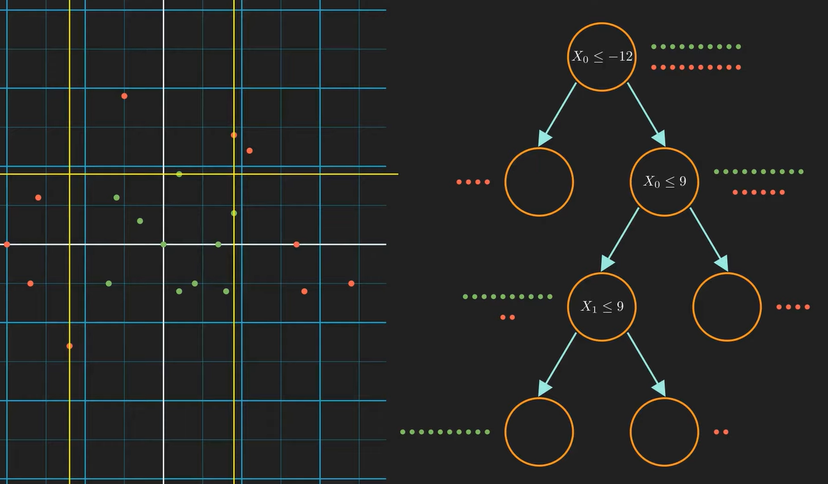
https://www.youtube.com/watch?v=ZVR2Way4nwQ

Slide 43
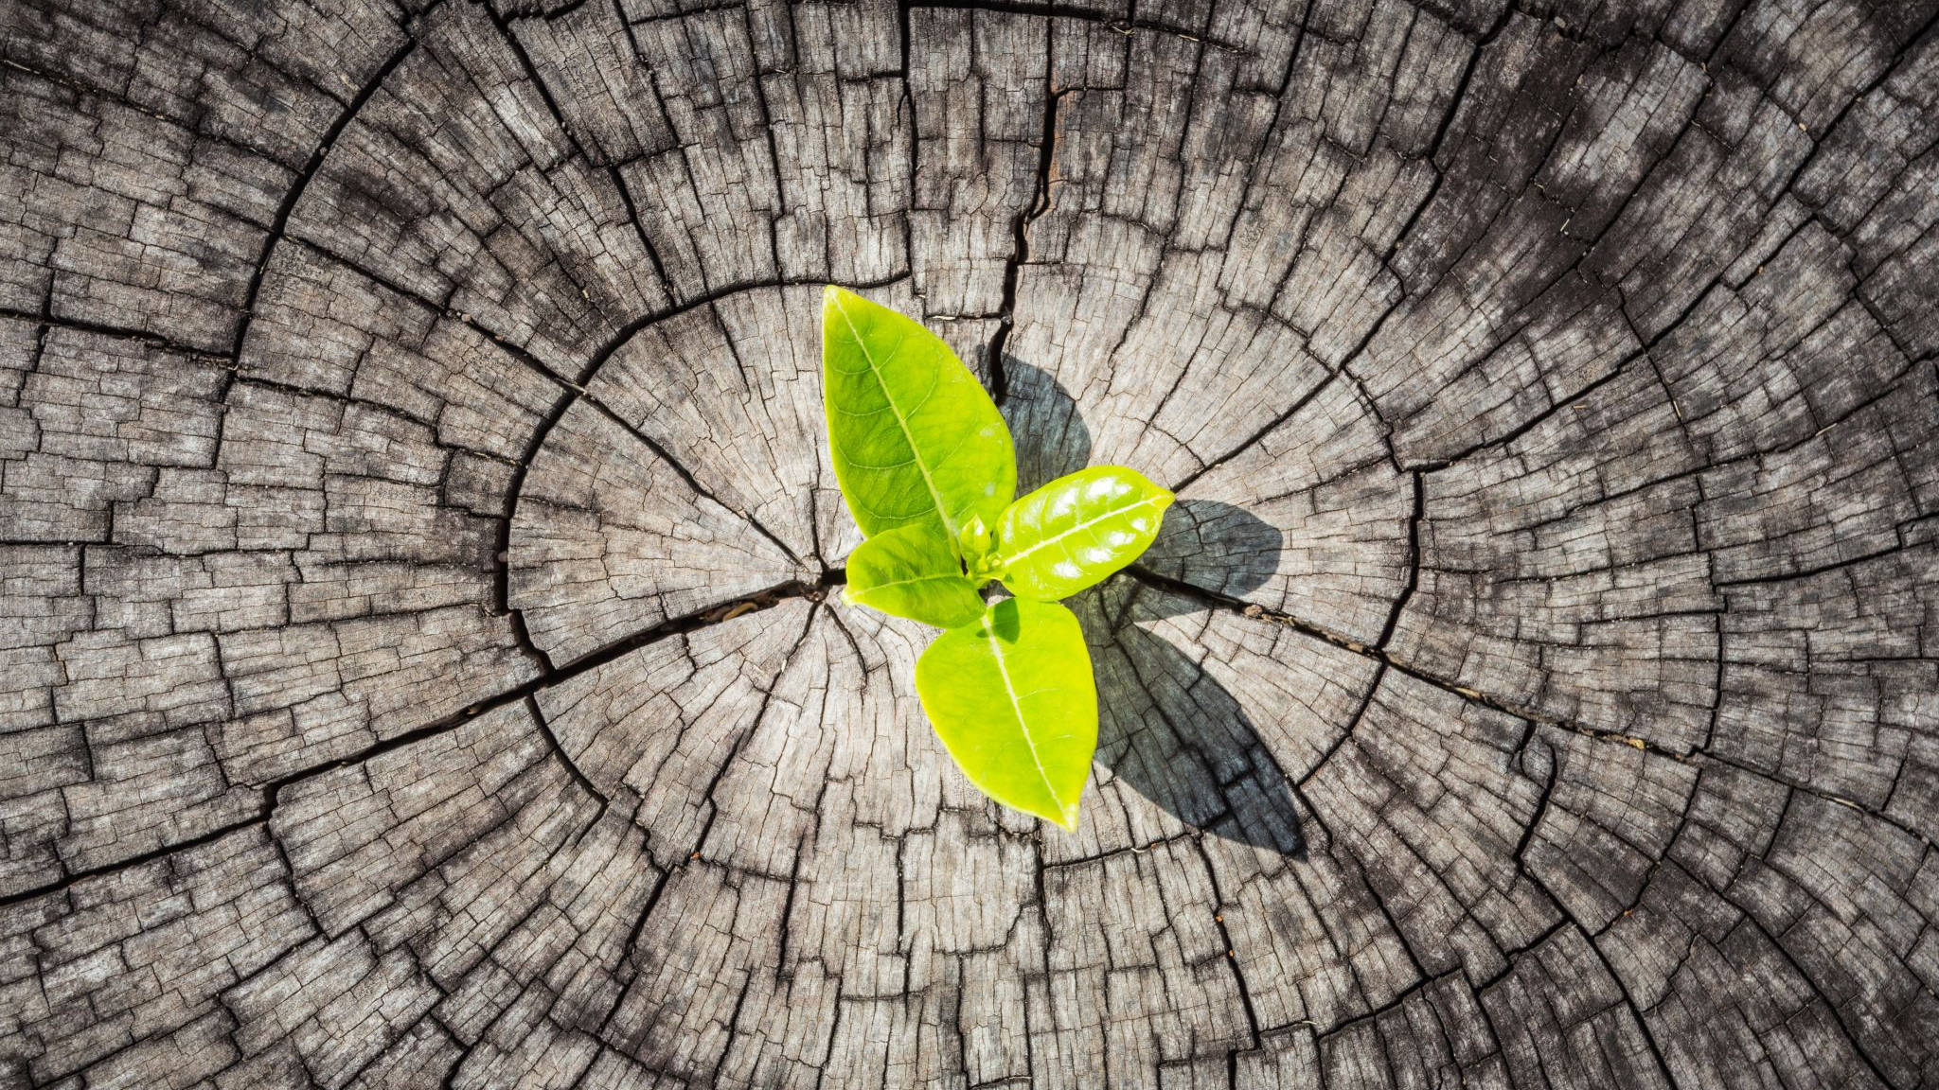
Decision Tree Experiments

Slide 44
Experiment 1. Decision Tree Accuracy vs Number of Classes
Research Question
How does the number of classes in the dataset affect the overall accuracy of the implemented tree?
Assumptions
Max Depth = 6; Minimum Samples = 20; Random State = 42.
Number of Classes | Overall Accuracy
256 | 0.0141
20 | 0.1867
10 | 0.3667
5 | 0.4800
3 | 0.7556
2 | 0.8333

Slide 45
Conclusions
Accuracy increases as the number of classes decreases due to lower class ambiguity and simpler decision boundaries.
The tree performs significantly better than random guessing, especially when the number of classes is small.
Limiting max_depth and min_samples acts as pre-pruning, preventing overfitting but possibly underfitting larger class sets.

Slide 46
Experiment 2. Effect of Tree Depth and Minimum Samples per Leaf on Validation Accuracy
Research Question
How do the maximum tree depth and minimum samples per leaf hyperparameters affect the validation accuracy of a C4.5 decision tree on a multi-class dataset?
Assumptions
3 randomly chosen classes
Depth | 1 | 10 | 50 | 100 | 200 | 1000
1 | 0.4628 | 0.5068 | 0.4054 | 0.4764 | 0.4662 | 0.4493
3 | 0.6554 | 0.6014 | 0.4932 | 0.5507 | 0.5000 | 0.4831
5 | 0.6047 | 0.6757 | 0.6284 | 0.6081 | 0.5574 | 0.5676
20 | 0.6993 | 0.6554 | 0.6824 | 0.7196 | 0.6284 | 0.5169
50 | 0.7027 | 0.7095 | 0.6655 | 0.6588 | 0.7061 | 0.5912
100 | 0.6486 | 0.6723 | 0.6993 | 0.6385 | 0.6858 | 0.6115

Slide 47
Comments
Shallow trees (depth 1–3): Accuracy is low to moderate because the tree is too simple. Increasing the minimum samples slightly improves performance.
Medium-depth trees (depth 5–20): Accuracy improves noticeably. The best results are at depth 20 with min_samples 100, showing a good balance between learning the data and avoiding overfitting.
Deep trees (depth 50–100): Accuracy is generally high, but very small leaves (min_samples 1) can overfit, while very large leaves (min_samples 1000) underfit.
Best choice: Depth 20–50 with min_samples 50–200 gives high accuracy without making the tree too complex.
Overall trend: Increasing depth helps accuracy up to a point, but leaf size must be tuned to avoid overfitting or underfitting.

Slide 48
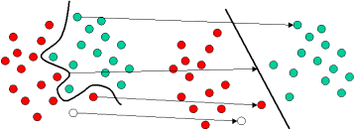
SVM

Slide 49
inspiration
How to implement SVM (Support Vector Machine) from scratch
https://www.youtube.com/watch?v=T9UcK-TxQGw by assemblyAI

Slide 50

Main algorithms / methods used
Stochastic Gradient Descent
One-vs-Rest (OvR) Strategy
Radial Basis Function (RBF) Kernel

Slide 51
Main problems
Curse of Dimensionality & Scalability
Computational Complexity of Kernel SVM
Class Imbalance in One-vs-Rest

Slide 52
Experiment
Experiment 1 – Linear vs. Kernel unbalanced
sample_index | correct_label | linear_pred | linear_correct | kernel_pred | kernel_correct
0 | 407 | 128 | 0 | 389 | 0
1 | 444 | 372 | 0 | 51 | 0
2 | 117 | 418 | 0 | 366 | 0
3 | 30 | 418 | 0 | 51 | 0
4 | 415 | 248 | 0 | 51 | 0
5 | 157 | 143 | 0 | 51 | 0
6 | 325 | 69 | 0 | 291 | 0
7 | 447 | 58 | 0 | 355 | 0
8 | 268 | 34 | 0 | 355 | 0
9 | 297 | 251 | 0 | 263 | 0
10 | 131 | 190 | 0 | 68 | 0

Slide 53
conclusions​
Metric | Linear Model | Kernel Model
Accuracy | 0.0% (0/45) | 0.0% (0/45)
Prediction Strategy | Scattered/Noisy: Predicted 39 unique classes. | Biased/Collapsed: Predicted only 11 unique classes.
Dominant Predictions | Class 202 (4 times) | Class 51 (10 times), Class 68 (10 times)
Diagnosis | High Variance / Failure to separate. | High Bias / Overfitting to majority priors.

Slide 54
Experiment
Experiment 1 – Linear vs. Kernel balanced
sample_index | correct_label | linear_pred | linear_correct | kernel_pred | kernel_correct
0 | 804 | 804 | 1 | 568 | 0
1 | 479 | 479 | 1 | 251 | 0
2 | 561 | 479 | 0 | 251 | 0
3 | 440 | 440 | 1 | 251 | 0
4 | 489 | 489 | 1 | 568 | 0
5 | 568 | 568 | 1 | 539 | 0
6 | 489 | 489 | 1 | 539 | 0
7 | 440 | 440 | 1 | 539 | 0
8 | 501 | 501 | 1 | 539 | 0
9 | 568 | 561 | 0 | 251 | 0
10 | 251 | 489 | 0 | 440 | 0

Slide 55
conclusions​
Metric | Linear Model | Kernel Model
Accuracy | 71.1% (32/45 Correct) | 11.1% (5/45 Correct)
Prediction Diversity | Predicted all 10 unique classes. | Predicted only 4 unique classes = Collapsed:
Dominant Prediction | Balanced distribution across classes. | Class 539 (Predicted 27 times, 60% of total).
Status | Good generalization. | Model collapse

Slide 56
Experiment 2 – Lambda vs Accuracy
Lambda | Unbalanced Train Acc | Unbalanced Test Acc | Unbalanced Time (s) | Balanced Train Acc | Balanced Test Acc | Balanced Time (s)
0,00001 | 0.9926 | 0.0000 | 951.84 | 0.9654 | 0.8222 | 1287.10
0.0001 | 0.9926 | 0.0000 | 435.41 | 0.9654 | 0.8222 | 761.52
0.001 | 0.9951 | 0.0000 | 430.67 | 0.9679 | 0.8222 | 764.05
0.01 | 0.9926 | 0.0000 | 432.18 | 0.9679 | 0.8222 | 447.09
0.1 | 1.0000 | 0.0000 | 433.36 | 0.9556 | 0.8000 | 213.72
1.0 | 0.9654 | 0.0000 | 450.85 | 0.8889 | 0.7556 | 224.53

Slide 57
conclusions​
Feature / Metric | Unbalanced Dataset (The Failure) | Balanced Dataset (The Solution)
Test Accuracy | 0.0% | ~82.2%
Training Accuracy | Up to 100% | ~96%
Generalization | Model memorized the training data but failed to identify any test samples correctly. | The model successfully learned decision boundaries that apply to unseen data.
Effect of Regularization | Ineffective - had no impact on the 0% test accuracy. | Effective. Low lambda = stable accuracy.

Slide 58
Classifiers comparison experiments

Slide 59
Unbalanced dataset comparison (1000 classes) -> Artificial Neural Network
Learning rate: 0.0001

Slide 60
Unbalanced dataset comparison (1000 classes) -> SVM
Different lambdas
Lambda | Train_Accuracy | Test_Accuracy | Time_Seconds
0.00001 | 0.9925925925925926 | 0.0 | 951.84
0.0001 | 0.9925925925925926 | 0.0 | 435.41
0.001 | 0.9950617283950617 | 0.0 | 430.67
0.01 | 0.9925925925925926 | 0.0 | 432.18
0.1 | 1.0 | 0.0 | 433.36
1.0 | 0.9654320987654321 | 0.0 | 450.85

Slide 61
Unbalanced dataset comparison (1000 classes)
Decision Tree
Max Depth | Min Samples per Leaf | Accuracy
10 | 500 | 0.0331
10 | 1000 | 0.0328
10 | 2000 | 0.0235
12 | 500 | 0.0354
12 | 1000 | 0.0317
12 | 2000 | 0.0318
14 | 500 | 0.0339
14 | 1000 | 0.0394
14 | 2000 | 0.0281
16 | 500 | 0.0375
16 | 1000 | 0.0420
16 | 2000 | 0.0361

Slide 62
Unbalanced dataset comparison (3 classes)
Decision Tree
Max Depth / Min Samples | 10 | 20 | 50 | 100
4 | 0.5541 | 0.5709 | 0.5811 | 0.5338
6 | 0.6588 | 0.6554 | 0.6250 | 0.6149
8 | 0.6791 | 0.7095 | 0.6858 | 0.6149
10 | 0.6554 | 0.6453 | 0.7297 | 0.6554

Slide 63
Comparison of heads
Model | Accuracy
Neural Network | 0.0%
Decision Tree | 4.2%
SVM | 0.0%

Slide 64
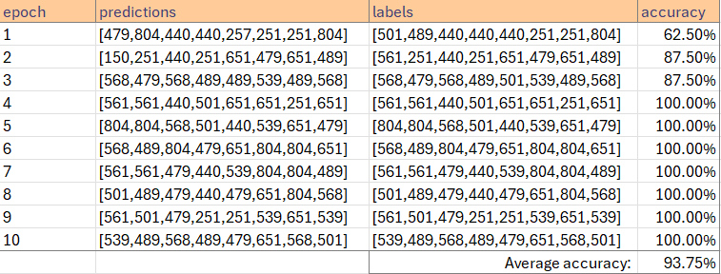
Balanced dataset comparison (10 classes) -> Artificial Neural Network
Learning rate: 0.005

Slide 65
Balanced dataset comparison (10 classes)
Decision Tree
Max Depth | Min Samples per Leaf | Validation Accuracy
4 | 20 | 0.1933
4 | 50 | 0.2933
4 | 100 | 0.2600
6 | 20 | 0.2667
6 | 50 | 0.3400
6 | 100 | 0.3200
8 | 20 | 0.2667
8 | 50 | 0.4200
8 | 100 | 0.2400

Slide 66
Balanced dataset comparison (10 classes) -> SVM
Different lambdas
Lambda | Train_Accuracy | Test_Accuracy | Time_Seconds
0.00001 | 0.9654320987654321 | 0.8222222222222222 | 1287.1
0.0001 | 0.9654320987654321 | 0.8222222222222222 | 761.52
0.001 | 0.9679012345679012 | 0.8222222222222222 | 764.05
0.01 | 0.9679012345679012 | 0.8222222222222222 | 447.09
0.1 | 0.9555555555555556 | 0.8 | 213.72
1.0 | 0.8888888888888888 | 0.7555555555555555 | 224.53

Slide 67
Comparison of heads
Model | Accuracy
Neural Network | 93.75%
Decision Tree | 42.00%
SVM | 80.56%

Slide 68
Conclusions
Class balance matters: Models perform drastically better on a reduced, balanced set.
Neural Networks excel with embeddings and few classes but fail on extreme class imbalance.
Decision Trees are more robust on unbalanced datasets when the number of classes is small but can underperform when the dataset is balanced and more complex.
SVM performs consistently but cannot handle extremely unbalanced datasets with many classes.

Slide 69
References
Wang, Yansong, and Xian Hu. "Machine learning-based image recognition for rural architectural planning and design." Neural Computing and Applications 37.13 (2025): 8073-8082.(cited as RA)
Abdullah, Dakhaz Mustafa, and Adnan Mohsin Abdulazeez. "Machine learning applications based on SVM classification a review." Qubahan Academic Journal 1.2 (2021): 81-90. (cited as SVM)
Asadollahfardi, Gholamreza. "Artificial neural network." Water Quality Management: Assessment and Interpretation. Berlin, Heidelberg: Springer Berlin Heidelberg, 2014. 77-91. (cited as ANN)
Lee, C. S., Cheang, P. Y. S., & Moslehpour, M. (2022). Predictive analytics in business analytics: Decision tree. Advances in Decision Sciences, 26(1), 1-29. Retrieved from https://www.proquest.com/scholarly-journals/predictive-analytics-business-decision-tree/docview/2674049708/se-2 (cited as AS)

